Slide 1


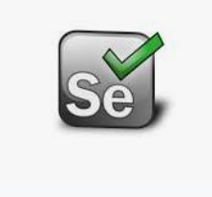



Selenium Grid
Hub
Node
Node
Node
Health check
Grid Console
Selenium Test

Slide 2
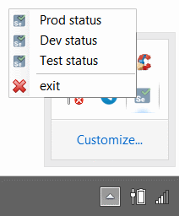
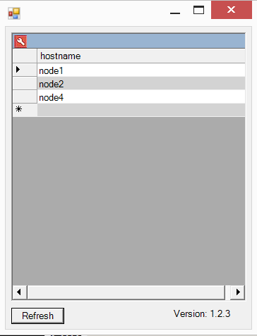
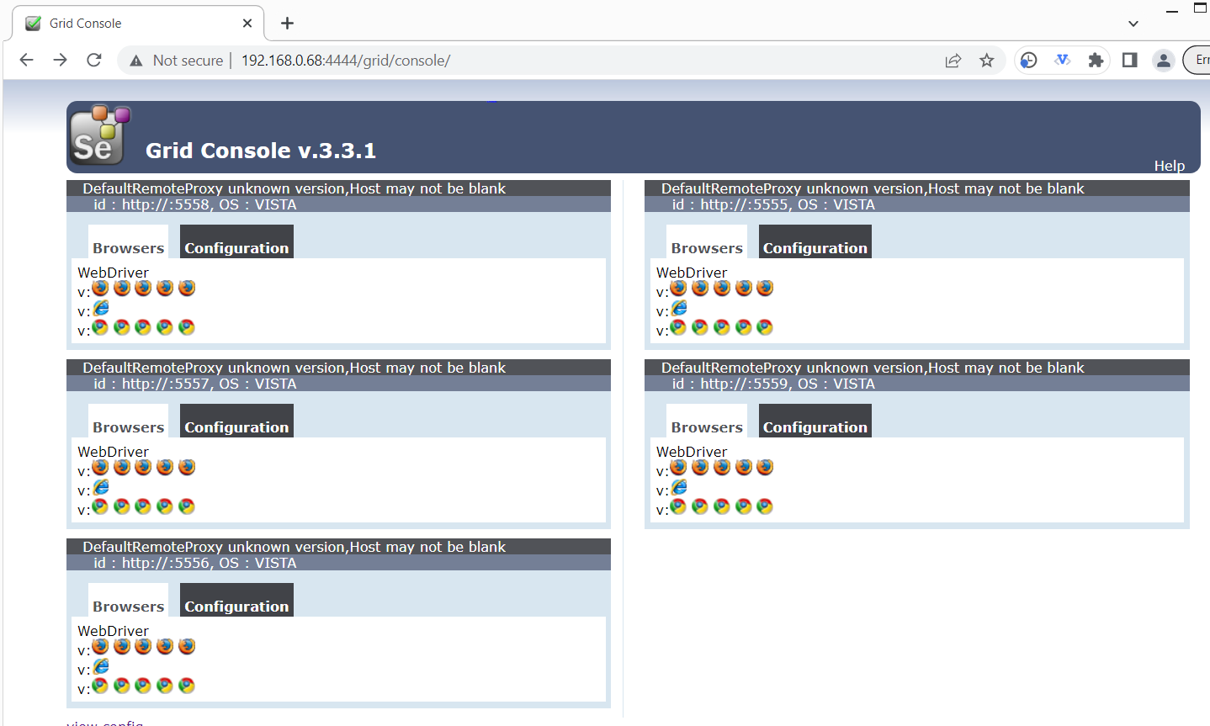
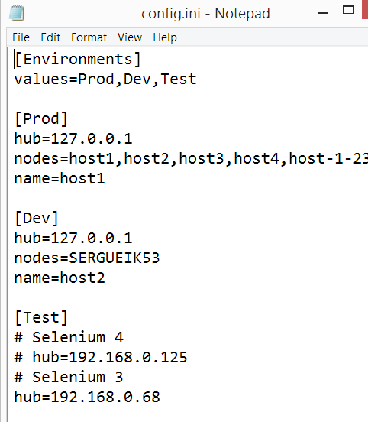
Grid Health Check
HTML Page scraped through
System.Windows.Forms.WebBrowser.WebBrowser

Slide 3
Alternatives
browser option | advantage | disadvantage
Windows interactive user desktop | easy to troubleshoot and setup | requires interactive logon through credential provider
Windows headless | can run w/o logon e.g. through Task Scheduler | complex tool chain to troubleshoot often code added to report failures somewhat less reliable
Windows service desktop | can be run w/o logon | screen dimensions tweaks required discouraged with windows 10 onward
Unix on virtual desktop | run as shell script by cron can run on generic machine | complex setup: must include X Windows server (VNC or XVFB)
Unix headless | needs no X windows | same as Windows headless
Docker | same as Unix | Same as Unix

Slide 4
Grid Health Check

Slide 5
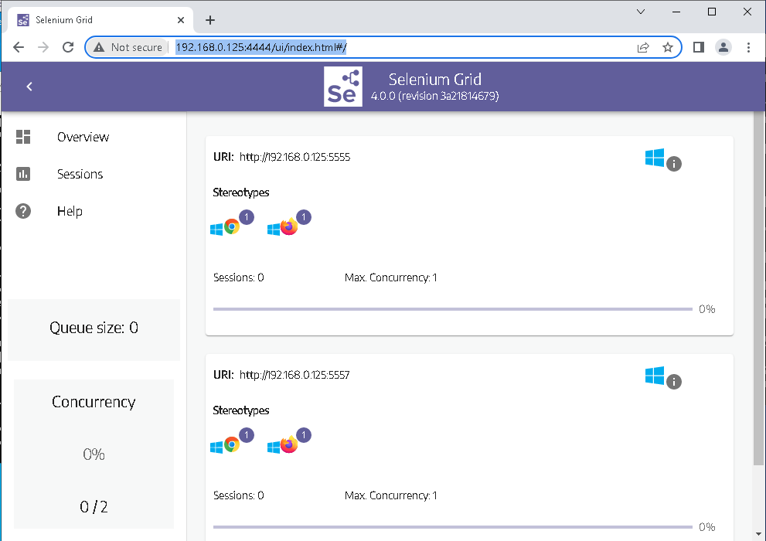
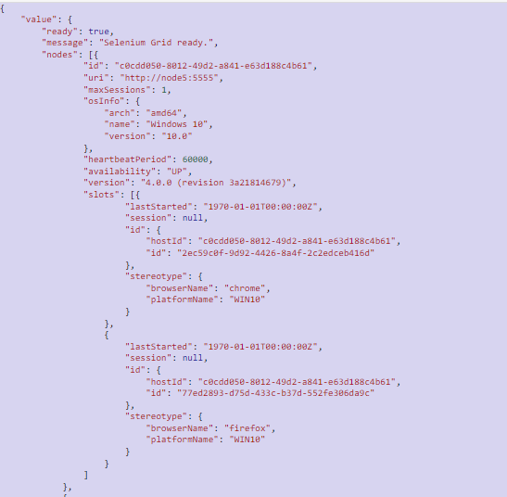
Grid Health Check for Selenium 4
GET http://192.168.0.68:4444/status
System.Windows.Forms.WebBrowser.WebBrowser lacks Jquery support
REST calls done through System.Net.HttpWebRequest
JSON serialization through System.Web.Script.Serialization.JavaScriptSerializer.JavaScriptSerializer

